Slide 1

By: Abishek Neupane
BCA 7th Sem,Xavier
Abishek Neupane

Slide 2
Table of Contents
Introduction
Definition
Purposes
Benefits/Advantages
Examples
Uses in industries
Steps & Process
Principles
Tools Used in R.E
Technical Risks
Conclusion
Abishek Neupane

Slide 3
Introduction
Engineering is the act of developing such tools that ease human life
There are two terms:
“Forward engineering is the development of the application or high-level model with the given requirement including scratch or low-level information."
"Backward engineering is reverse of it, as here all the detailed information is collected from the existing application and system or device, it is also known as Reverse Engineering."
Abishek Neupane

Slide 4
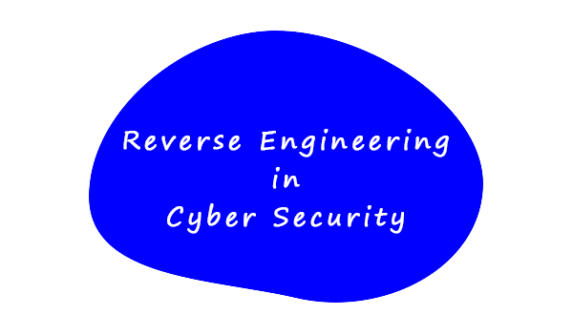
Abishek Neupane

Slide 5
Definition
“Reverse engineering is a process in which a product is deconstructed to extract design information including machines, aircrafts, software, architectural structure and many more or a method of deconstructing individual component of large components.”
For example: When a machine is created/ made by an engineer is called forward engineering, and when the device/machine gets older, when its parts malfunction or break down completely, then its component are replaced, not the whole device. This is called reverse engineering.
Abishek Neupane

Slide 6
Purposes :
As a way to make new products
As a learning tool
Preparing cheaper products compared to what's currently on the market
Bridge data between different databases or operating system
To uncover the undocumented features of commercial products
Abishek Neupane

Slide 7
Benefits or Advantages
Utilize in recreating a product
In repairing the existing products
To explore an existing product
An inspiring innovation
To discover vulnerabilities of product
Conducting failure analysis
To reduce the development cost of the product.
Abishek Neupane

Slide 8
Examples of Reverse Engineering
Computer parts: The system and its parts are deconstructed by the engineer to replace old parts with new ones or run a test on a broken part.
Network security assessment: They can be named red or blue teams, where one stimulates and monitors the attack.
Construction: To solve the design-related issues of a building. Using scanners, the engineer creates a 3D building design to study design flaws and fix them according to the information.
Abishek Neupane

Slide 9
Software: By using the software, engineers extract the codes or parts of the software and analyze them to understand their functionality and use.
It also helps in finding the application's loopholes and weaknesses and preventing them from exploitation by hackers.
Mechanical project: In mechanical engineering, reverse engineering is used on different products like vehicles, air conditioners, washing machines, cars, etc. After finding a solution or fixing malfunctioning, these parts are assembled again to rebuild the products.
Abishek Neupane

Slide 10
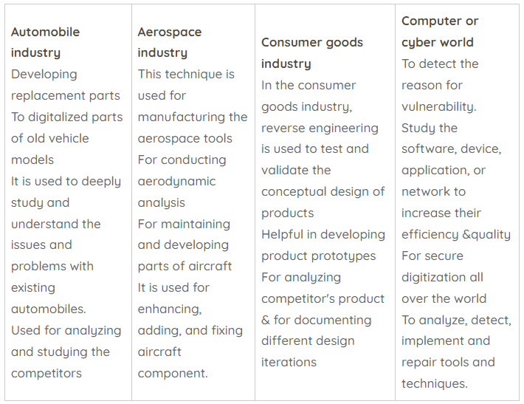
Reverse engineering is used in the following industries
Abishek Neupane

Slide 11
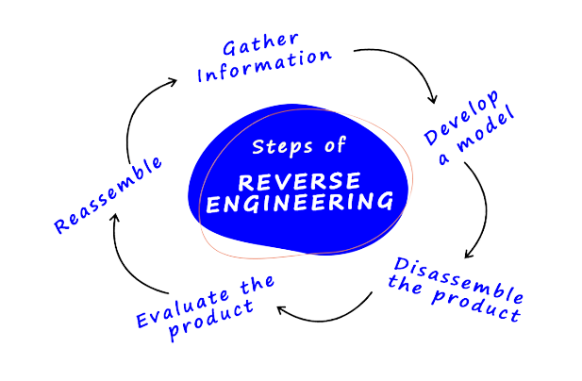
Steps for Reverse Engineering
Gather information
Develop a model
Disassemble the product
Evaluate the product
Reassemble
Abishek Neupane

Slide 12
Processes of Reverse Engineering :
System to be structured
Manual or automated analysis
System information store
Document generation
Traceability metrics, data structure, and program
structure use.
Abishek Neupane

Slide 13
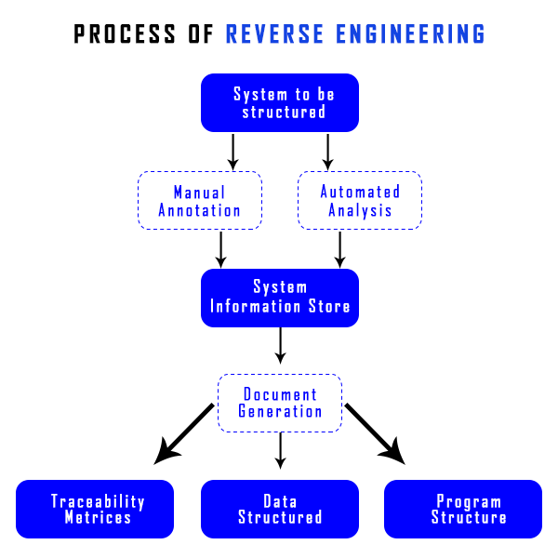
Abishek Neupane

Slide 14
Principles of Reverse Engineering
No need to mistake the hypothesis for the conclusion
Watch for a consistent style.
Expect odd constructs
No need to be discouraged by the approximated results
Abishek Neupane

Slide 15
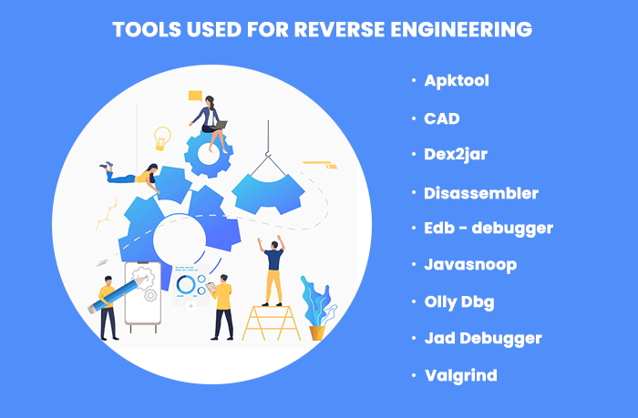
Tools used for reverse engineering
Abishek Neupane

Slide 16
Tools used for Reverse Engineering
CAD
Disassembler
System monitoring tools
Debuggers Decompilers
Apktool
Dex2jar
Edb-debugger
Javasnoop
OllyDbg
Jad Debugger
Valgrind
Abishek Neupane

Slide 17
Technical risk of Reverse Engineering
Confidentiality risk
Integrity risk
Abishek Neupane

Slide 18
Conclusion
Reverse engineering is a method or process in which a piece of hardware or software analyzes its functions and information flow to understand its behavior and functionality better.
In cyber security, it is used to create a defensive system or an unbreakable protection shield from cyber-attacks and criminals.
Abishek Neupane

Slide 19
For example: In cyber defense, malware is commonly reversed engineered. Reverse engineering is also a means to sustain competition in the market. Some of it is considered a tool to grab detailed knowledge about the product, learn about the design's flaws and rework for the same.
Various reverse engineering tools are available in the market, provided by Kali Linux, which are already built-in and come out of the box with Kali Linux
Abishek Neupane

Slide 20

Abishek Neupane

Slide 21

Abishek Neupane

